Slide 1

Resource Allocation System
Final Project (Presentation)
Professor Chintan Thakkar - IMT 543 B
Aniket Fadia
Srishti Dubey - 2122992

Slide 2
Allocating Employees (Resources) to projects within an organization
Why do we need this system?

Slide 3
Why do we need this system?
A solution for professional service companies to better manage their employees, budgets and profits
Optimizes the potential for your workforce
Better workforce utilization

Slide 4
Draft ERD

Slide 5
Tables Used in Draft ERD
Employee Detail Table
Compensation Table
General Skill Table
Employee Skill Table
General Project Table
Resource Lock Table

Slide 6
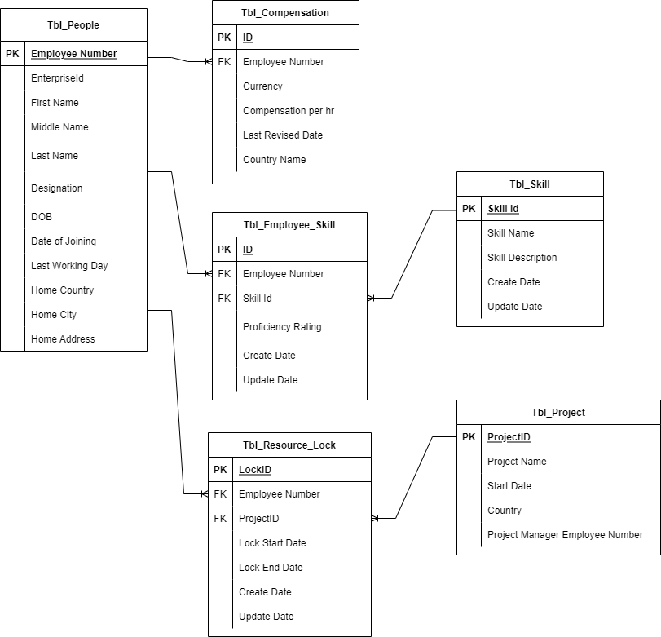

Slide 7
Revised ERD

Slide 8
Tables Used in Revised ERD
Employee Detail Table
Employee Address Table
Compensation Table
General Skill Table
Employee Skill Table
General Project Table
Resource Lock Table

Slide 9
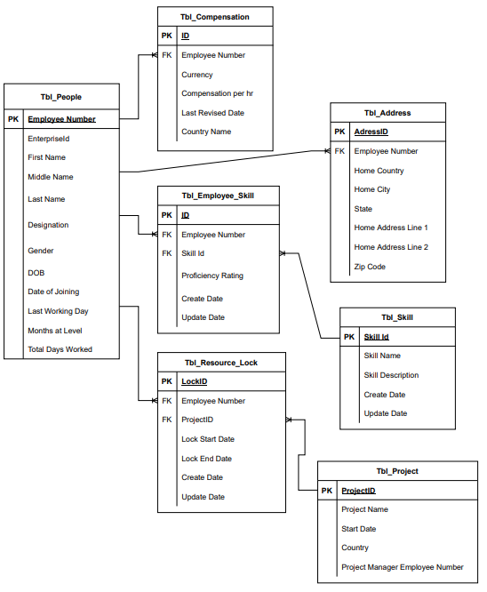

Slide 10
DDL/physical database design highlights

Slide 11
SERVER NAME : IS-HAY09.iSchool.uw.edu
DATABASE: [IMT_PROJ_2122992]

Slide 12
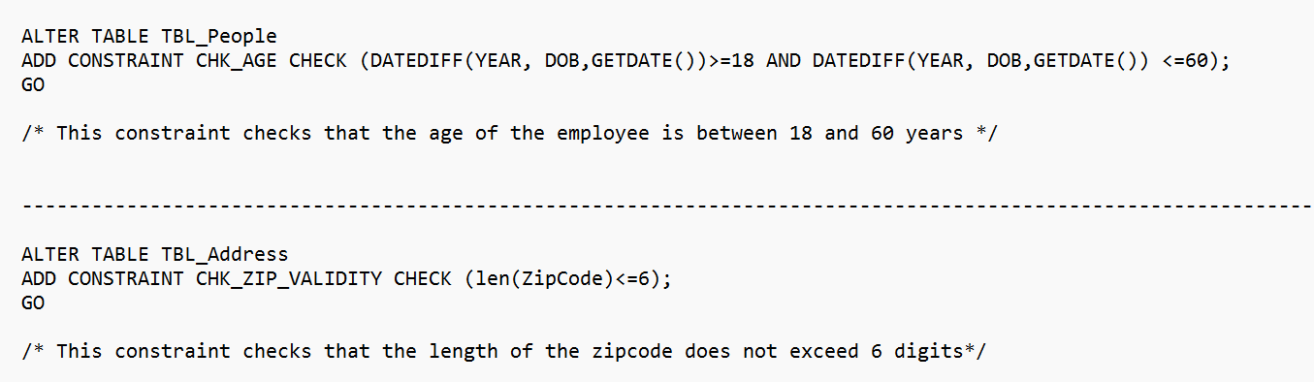
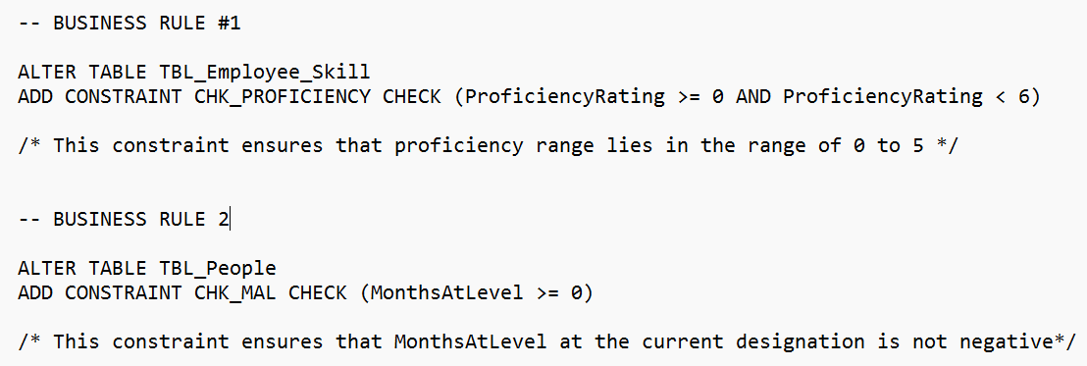
Business Rules Implemented

Slide 13
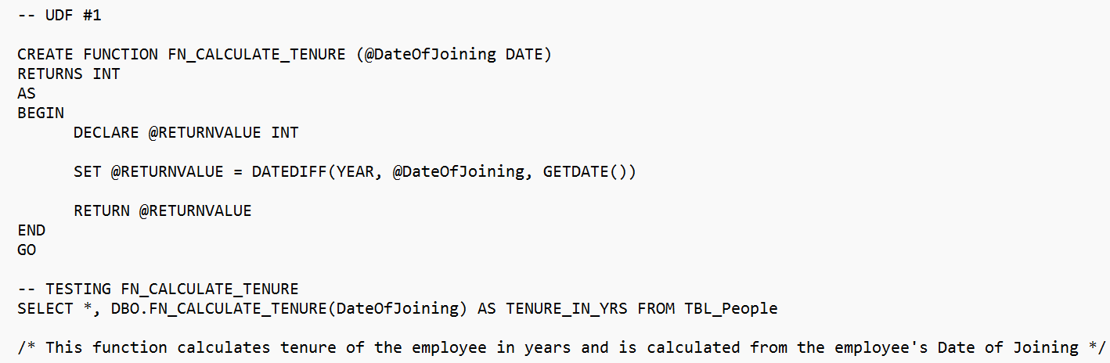
User Defined Functions Implemented

Slide 14
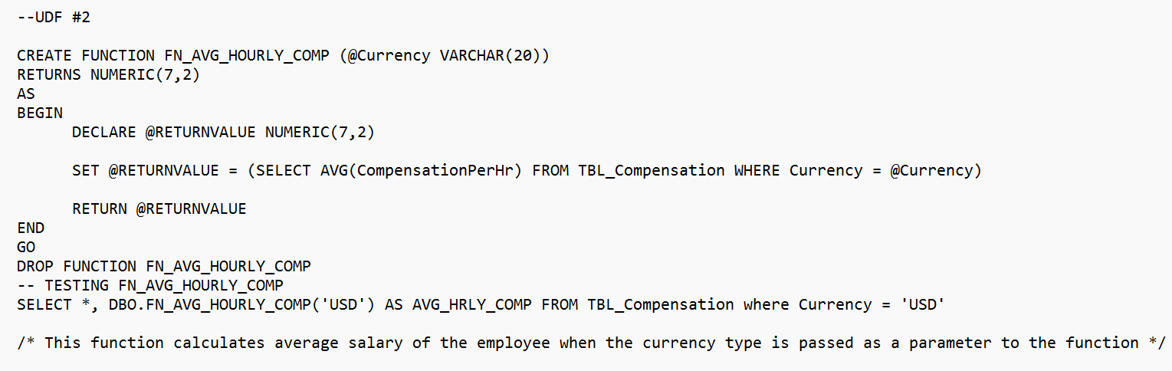

Slide 15
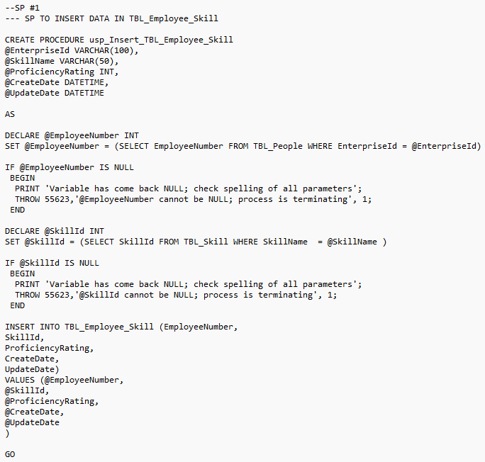
Stored Procedure

Slide 16
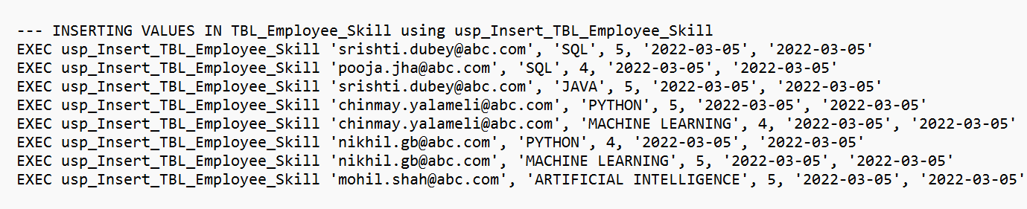

Slide 17
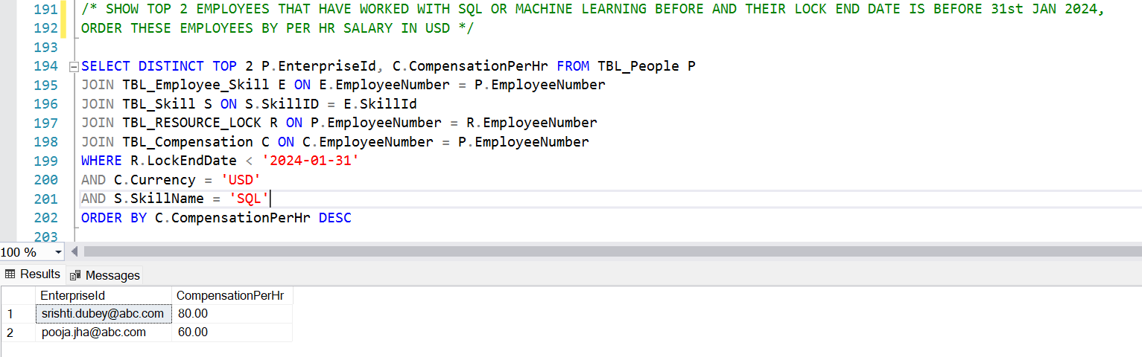
Executing a query

Slide 18
Takeaways

Slide 19
Implementing one-to-one and one-to-many relationships between tables
Understanding Primary-Foreign Key relationships
Inserting values in stored procedures with foreign keys and error handling
Creating and applying User Defined Functions
Applying Business Rules using constraints

Slide 20

Thank you for an awesome quarter!

